Slide 1
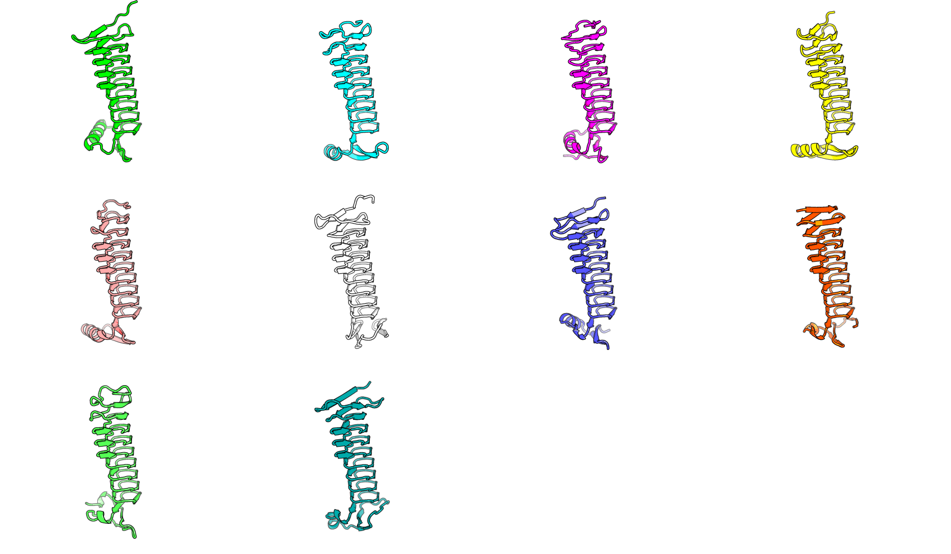
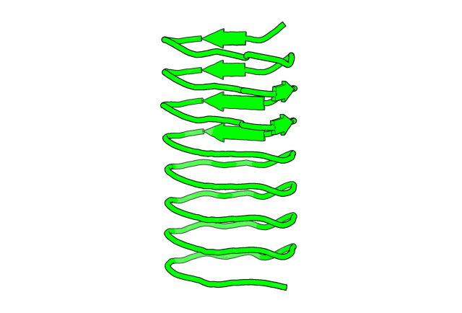
m1 default setting
I take 3ult as input pdb structure and use the default
Setting for adding free extension at the N ter and C ter.
The generated capping sequence has the following problem:
Rfdiffusion tends to extend the secondary structure token
from the backbone. So it is is start with beta-solenoid, it tends to
Extend the beta strand. That makes the capping not ‘cap’.
2. The distance between the extended capping structure and
The main body structure are either too far away or too angled.
That also makes them not ideal.
contigmap.contigs=[34/A2-114/34]
Flaw:
Tend to extend the original secondary structure
Cap is far away from main body
Surprised knowledge:
Rfdiffusion is biased with residue identity

Slide 2
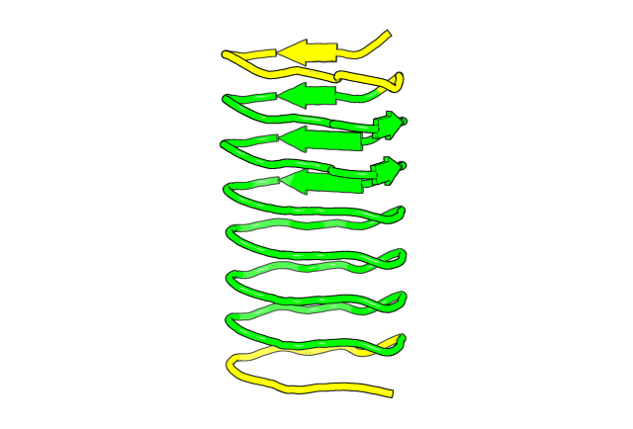
m3 inpaint + secondary strucgure + block adjacent
Give preference of secondary structure (scaffold guidance)
Give preference of contact map (block adjacent)
ENTENSION
LEEWAY
Inpaint to hide the amino acid identity
LEEWAY
ENTENSION

Slide 3
# Define N-terminal and C-terminal blocks
blocks = {
"N-terminal": (0, row['extend_len'] + 1 + LEEWAY),
"C-terminal": (chain_len - (row['extend_len'] + LEEWAY), chain_len)
}
# Populate adjacency matrix for the defined blocks
for (start, end) in blocks.values():
for x, y in itertools.product(range(start, end), repeat=2):
block_adj[x, y] = 1
for line in block_adj.numpy():
print(" ".join(map(lambda x: str(int(x)), line)))
# Define the alternating pattern for helix and mask
pattern = [3] * chain_len
alternating_pattern = [0, 0, 0, 3, 3, 3]
# Apply alternating pattern to N- and C-terminal blocks
blocks = {
"N-terminal": (0, blocks["N-terminal"][1] - GAP_LENGTH),
"C-terminal": (blocks["C-terminal"][0] + GAP_LENGTH, chain_len)
}
for start, end in blocks.values():
pattern[start:end] = [alternating_pattern[i % len(alternating_pattern)] for i in range(end - start)]
m3 inpaint + secondary strucgure + block adjacent
I take 3ult as input pdb structure and use the default
Setting for adding free extension at the N ter and C ter.
The generated capping sequence has the following problem:
Rfdiffusion tends to extend the secondary structure token
from the backbone. So it is is start with beta-solenoid, it tends to
Extend the beta strand. That makes the capping not ‘cap’.
2. The distance between the extended capping structure and
The main body structure are either too far away or too angled.
That also makes them not ideal.
So to solve the above two problems, I tried to provide the extension
A ‘preferred’ secondary structure rathat than let it freely choose.
That is done by providing a secondary structure guidance file in which
The 3 means mask and 1 means helix. Hence the entension would
Be a pattern of 000333, while the original 3ult structure’s secondary
Structure keeps unchanged as masked.
Furthermore, I provide a ‘fake’ contact map from which I define the
Contact between extension and leeway, hopefully that will alleviate the problem
Of the extension is always been too far away from the main body.
Last, realizing that the identity of amino acid from the 3ult can
Also influence the capping quality I used inpaint to mask the amino acids identity
Of the leeway.
contigmap.contigs=[35/A3-113/35]
contigmap.inpaint_seq=[A3-13/A103-113]
Secondary structure: 0-helix, 3-mask
ENTENSION
000333000333333333333333333330003330003
EXTENSION
LEEWAY
12345 …
1
LEEWAY
1
Contact map
LEEWAY
Inpaint
ENTENSION
G
G

Slide 4
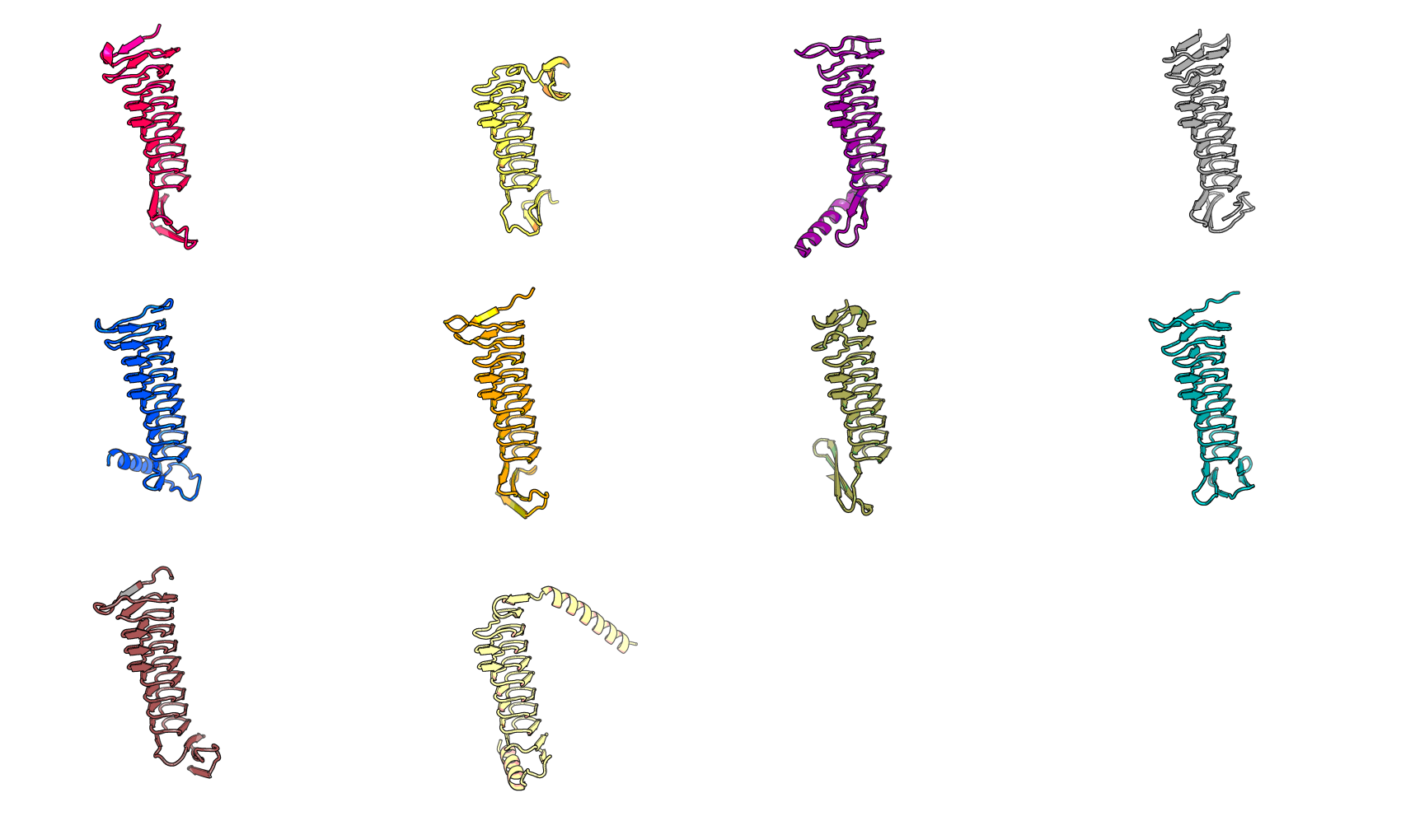
m3 inpaint + secondary strucgure + block adjacent
# Define N-terminal and C-terminal blocks
blocks = {
"N-terminal": (0, row['extend_len'] + 1 + LEEWAY),
"C-terminal": (chain_len - (row['extend_len'] + LEEWAY), chain_len)
}
# Populate adjacency matrix for the defined blocks
for (start, end) in blocks.values():
for x, y in itertools.product(range(start, end), repeat=2):
block_adj[x, y] = 1
for line in block_adj.numpy():
print(" ".join(map(lambda x: str(int(x)), line)))
# Define the alternating pattern for helix and mask
pattern = [3] * chain_len
alternating_pattern = [0, 0, 0, 3, 3, 3]
# Apply alternating pattern to N- and C-terminal blocks
blocks = {
"N-terminal": (0, blocks["N-terminal"][1] - GAP_LENGTH),
"C-terminal": (blocks["C-terminal"][0] + GAP_LENGTH, chain_len)
}
for start, end in blocks.values():
pattern[start:end] = [alternating_pattern[i % len(alternating_pattern)] for i in range(end - start)]

Slide 5
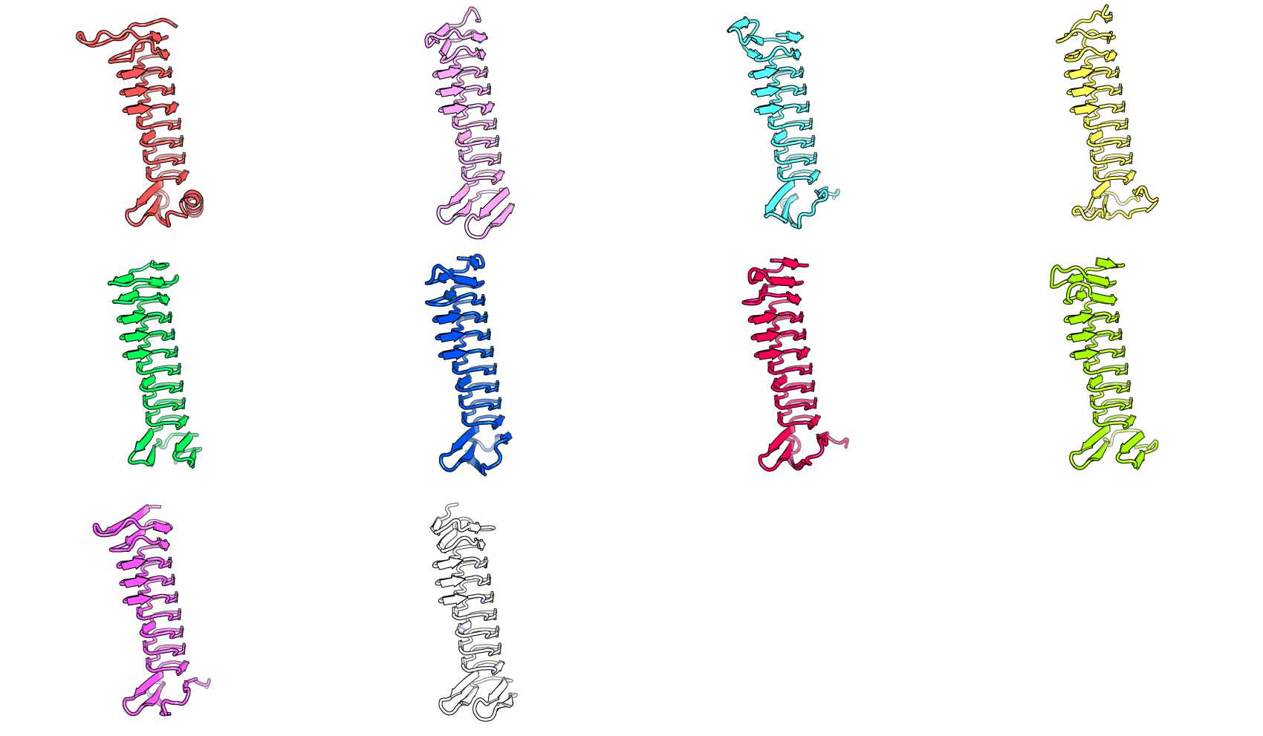
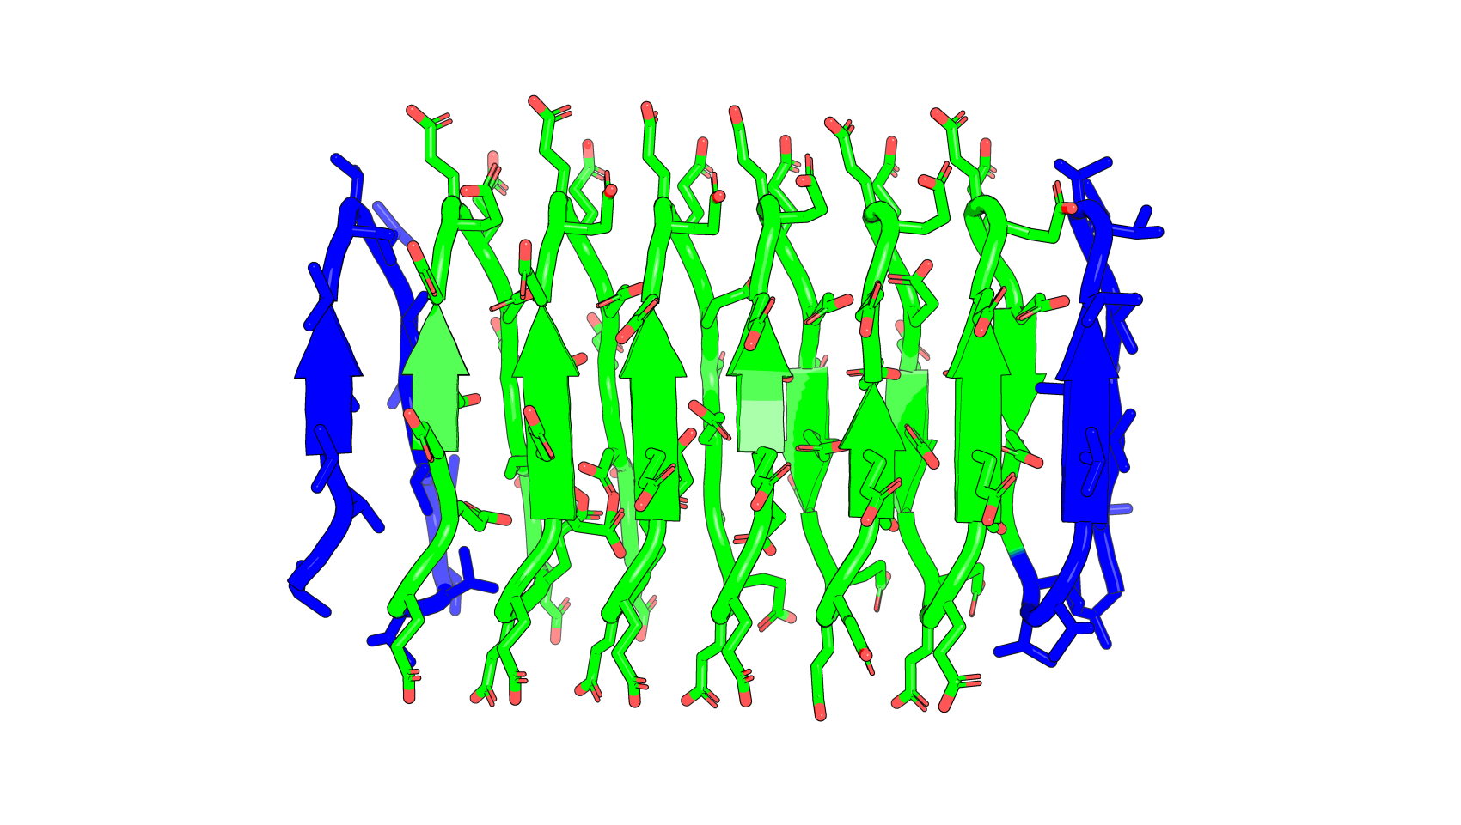
m4 Valine on both N and C terminus, Glutamate in main body (VE)
contigmap.contigs=[35/A2-114/35]
To verify that Rfdiffusion is indeed biased by
Residue identity:
The distance between cap and main body is closer – maybe fake residue identity can be used to replace or enhance contact map?
Valine Glutamate

Slide 6
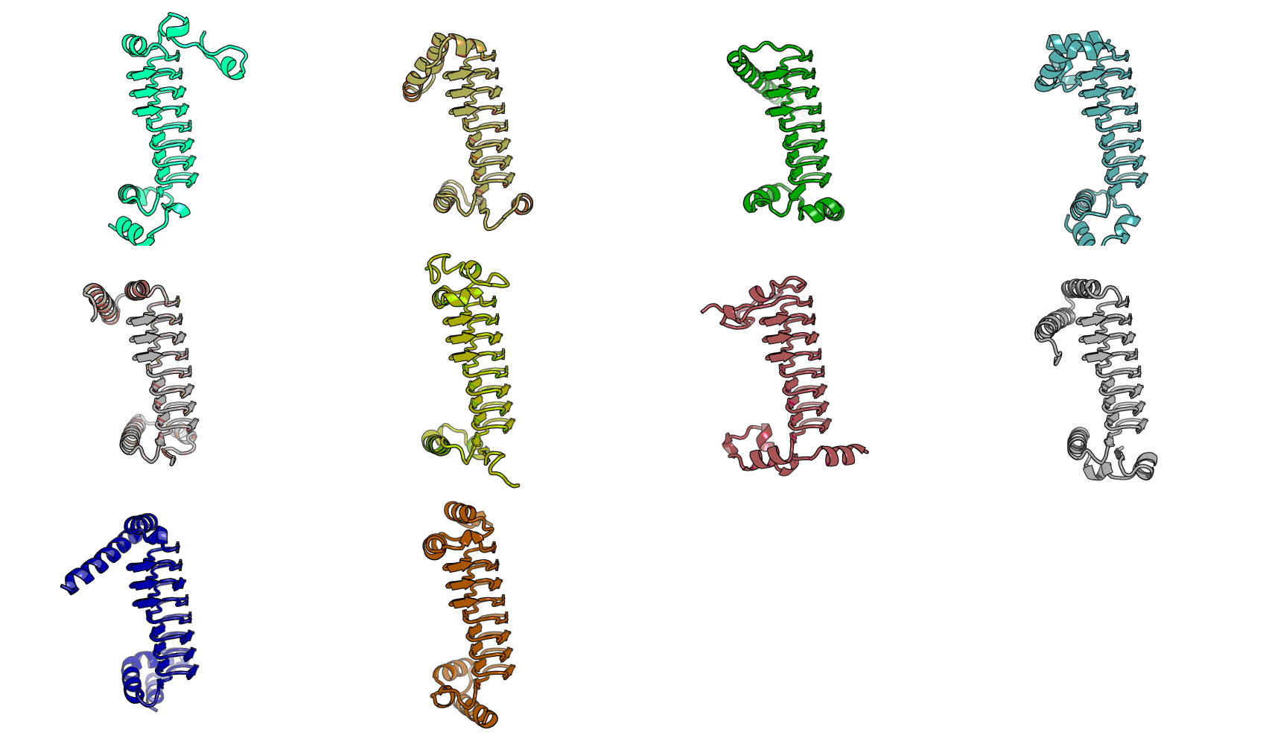
m5 VE + secondary structure + block adjacent
contigmap.contigs=[39/A2-114/39]
No inpaint, still provide block adjacent
The capping structure contains more helix even though the secondary structure scaffold is the same.

Slide 7
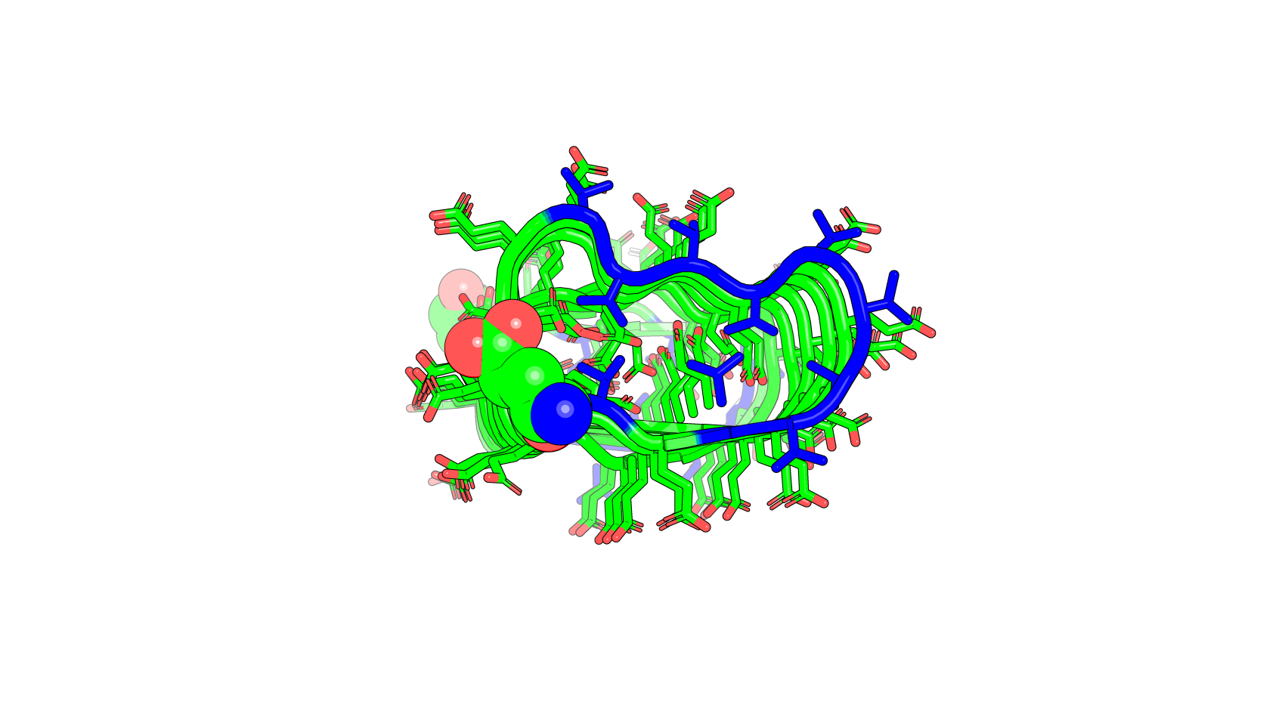
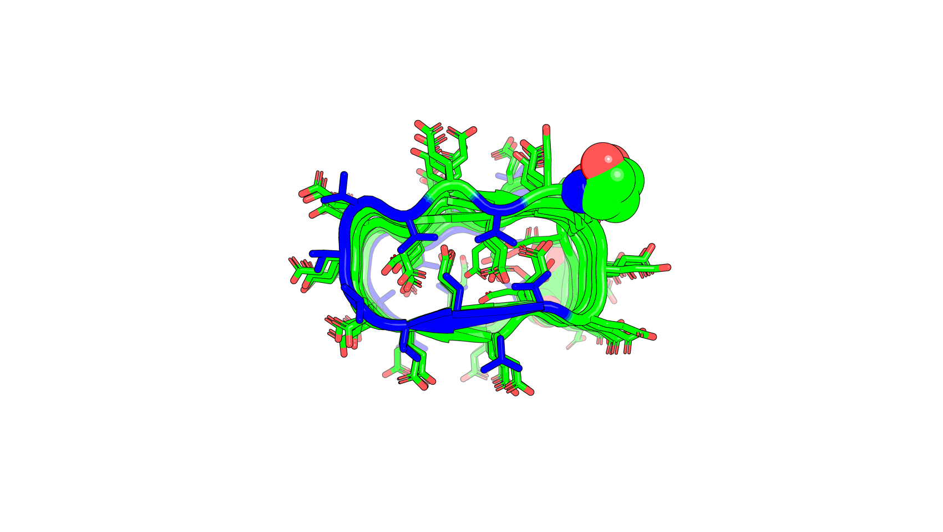
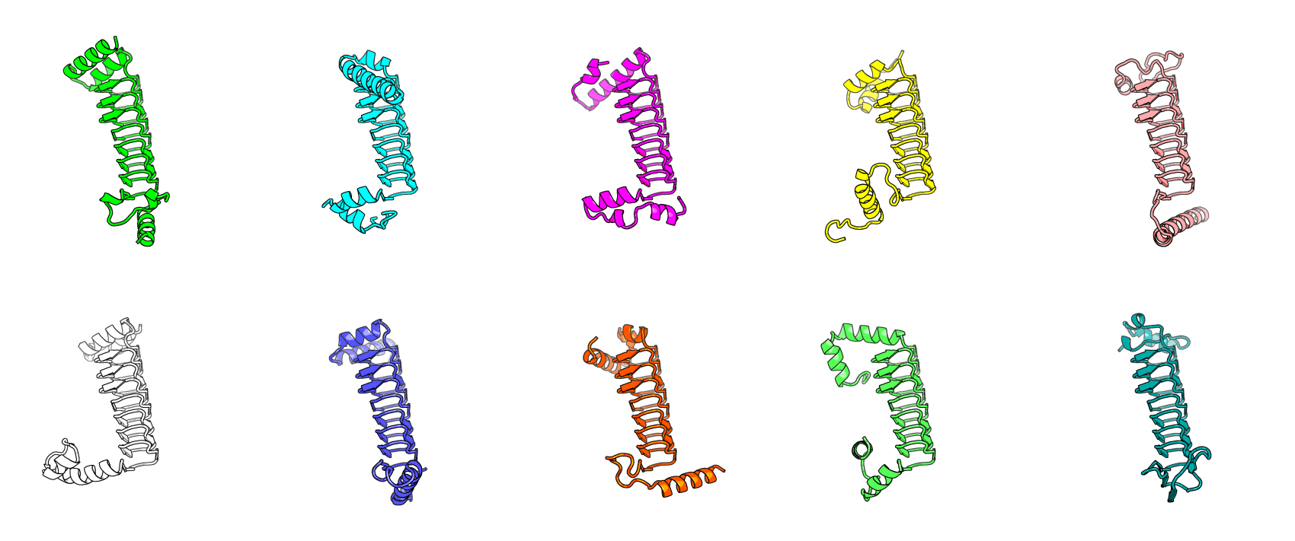
m6 fine tune VE + secondary structure + block adjacent

Slide 8
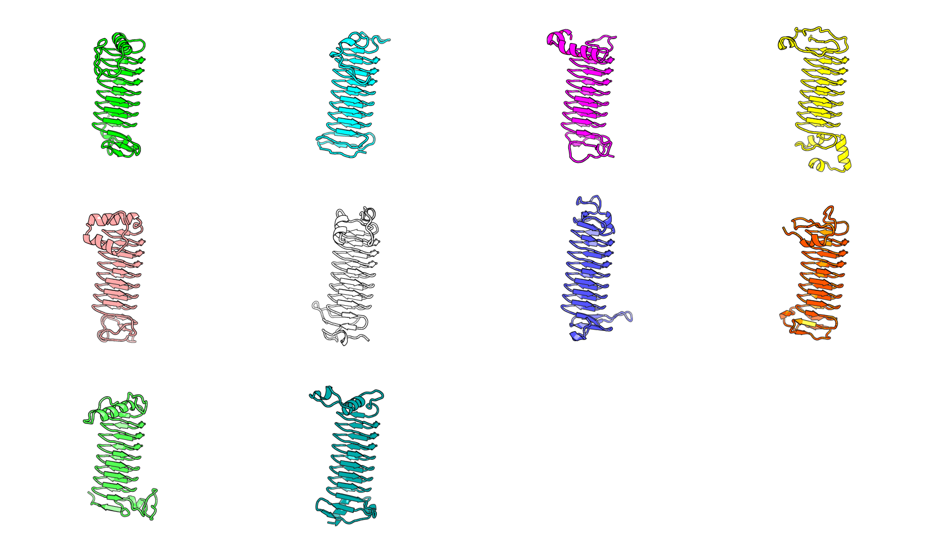
m7 fine tune VE + guided secondary structure + block adjacent
contigmap.contigs=[38/A1-114/38]
Pattern: [3, 3, 3, 3, 3, 3, 3, 3, 3, 3, 3, 3, 3, 3, 3, 3, 3, 3, 3, 3, 3, 3, 3, 3, 3, 3, 3, 3, 3, 3, 3, 3, 3, 3, 3, 3, 3, 3, 3, 3, 3, 3, 3, 3, 0, 0, 0, 0, 0, 0, 0, 3, 3, 3, 3, 3, 3, 3, 3, 3, 3, 3, 3, 3, 3, 3, 3, 3, 3, 3, 3, 3, 3, 3, 3, 3, 3, 3, 3, 3, 3, 3, 3, 3, 3, 3, 3, 3, 3, 3, 3, 3, 3, 3, 3, 3, 3, 3, 3, 3, 3, 3, 3, 3, 3, 3, 3, 3, 3, 3, 3, 3, 3, 3, 3, 3, 3, 3, 3, 3, 3, 3, 3, 3, 3, 3, 3, 3, 3, 3, 3, 3, 3, 3, 3, 3, 3, 3, 3, 3, 0, 0, 0, 0, 0, 0, 0, 3, 3, 3, 3, 3, 3, 3, 3, 3, 3, 3, 3, 3, 3, 3, 3, 3, 3, 3, 3, 3, 3, 3, 3, 3, 3, 3, 3, 3, 3, 3, 3, 3, 3, 3, 3, 3, 3, 3, 3, 3, 3, 3]

Slide 9
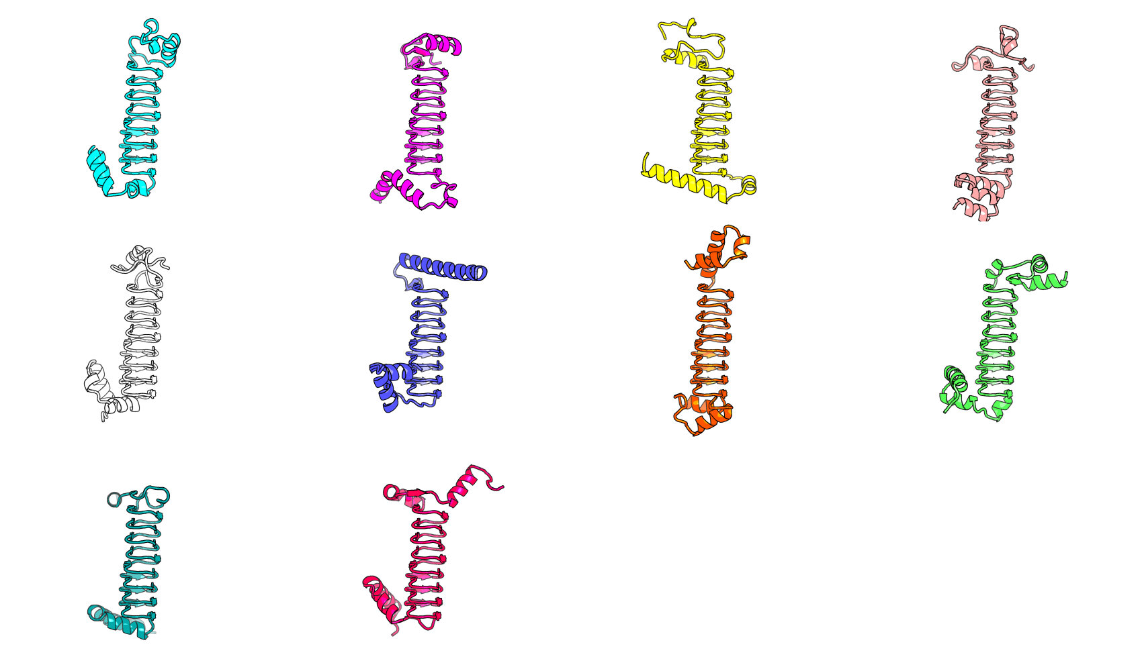
m8 fine tune VE + guided secondary structure + block adjacent
contigmap.contigs=[34/A1-114/34]
Pattern: [0, 0, 3, 3, 3, 3, 0, 0, 3, 3, 3, 3, 0, 0, 3, 3, 3, 3, 0, 0, 3, 3, 3, 3, 0, 0, 3, 3, 3, 3, 0, 0, 3, 3, 3, 3, 0, 0, 3, 3, 3, 3, 0, 0, 3, 3, 3, 3, 0, 0, 3, 3, 3, 3, 3, 3, 3, 3, 3, 3, 3, 3, 3, 3, 3, 3, 3, 3, 3, 3, 3, 3, 3, 3, 3, 3, 3, 3, 3, 3, 3, 3, 3, 3, 3, 3, 3, 3, 3, 3, 3, 3, 3, 3, 3, 3, 3, 3, 3, 3, 3, 3, 3, 3, 3, 3, 3, 3, 3, 3, 3, 3, 3, 3, 3, 3, 3, 3, 3, 3, 3, 3, 3, 3, 3, 3, 3, 3, 3, 3, 3, 3, 3, 3, 3, 3, 3, 3, 3, 3, 3, 0, 0, 3, 3, 3, 3, 0, 0, 3, 3, 3, 3, 0, 0, 3, 3, 3, 3, 0, 0, 3, 3, 3, 3, 0, 0, 3, 3, 3, 3, 0, 0, 3, 3, 3, 3, 0, 0, 3, 3, 3, 3, 0, 0, 3, 3, 3, 3, 0, 0, 3]

Slide 10
distance
angle
Structure motif split
RMSD
N cap
Center of mass
Center of mass
N extension
C extension
C cap

Slide 11
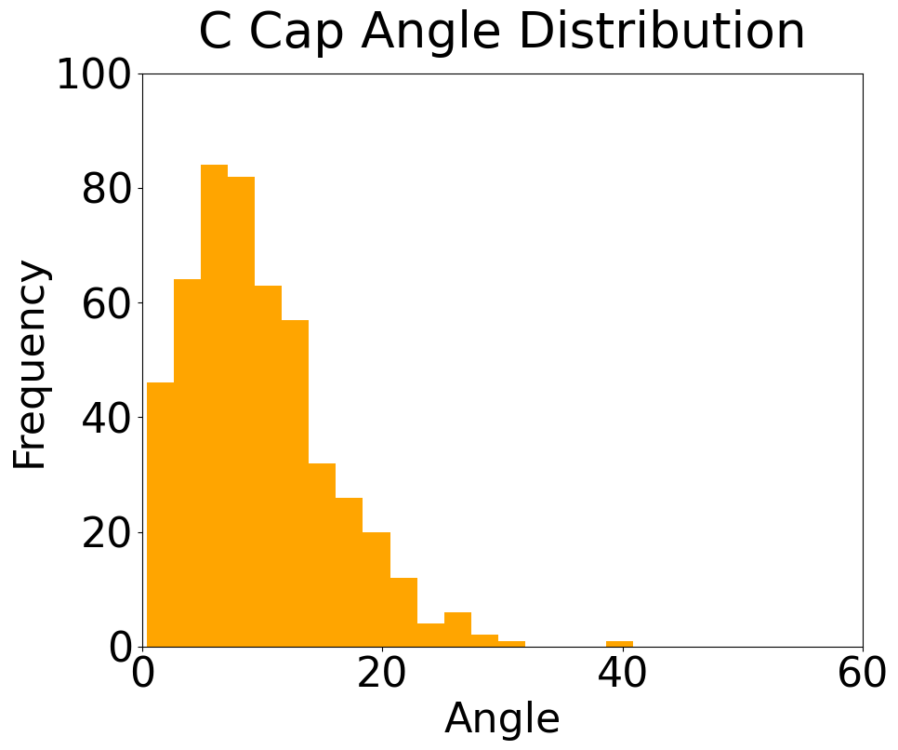
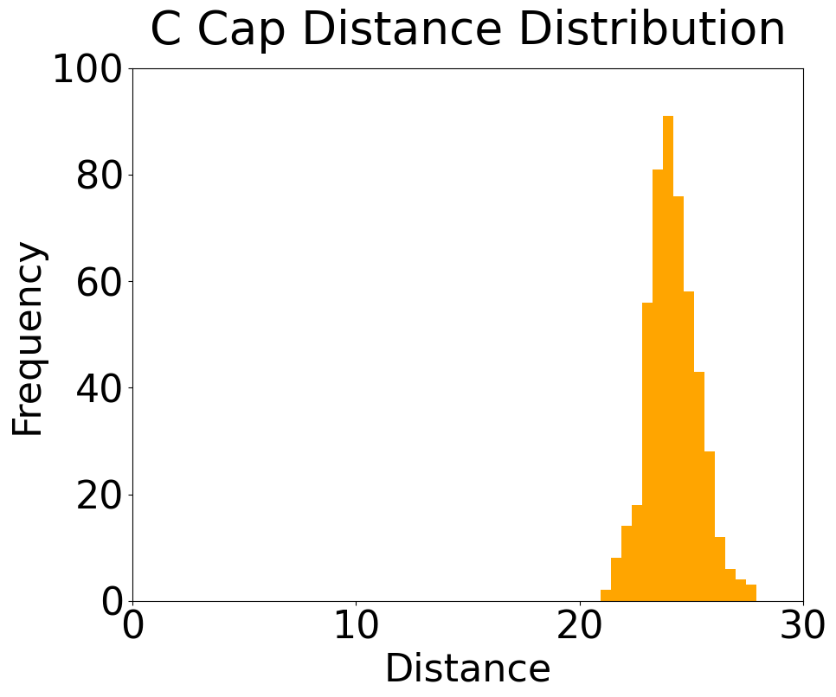
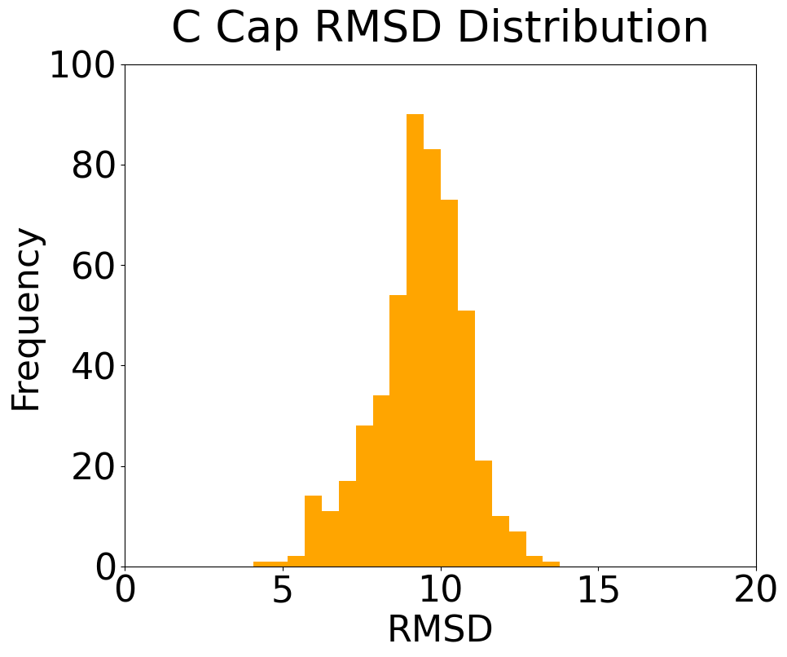
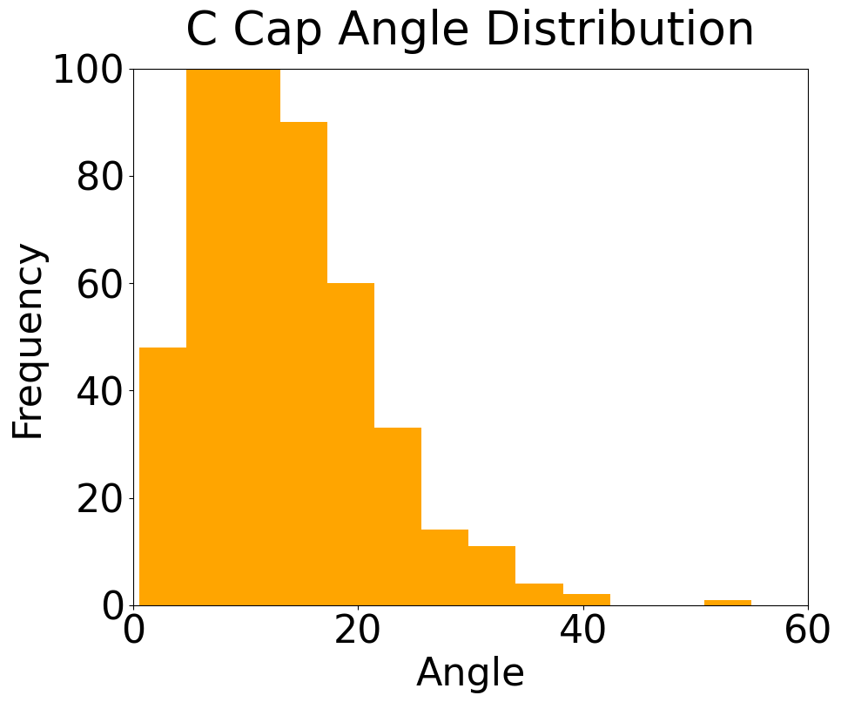
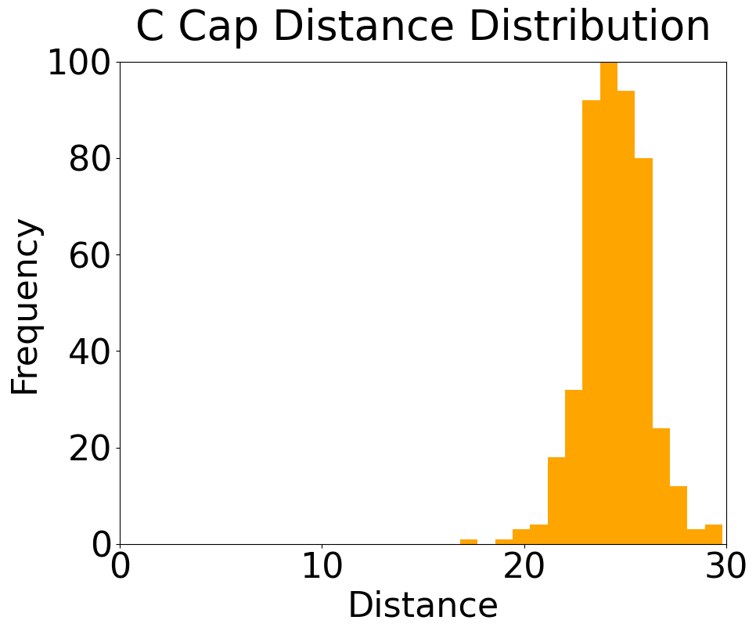
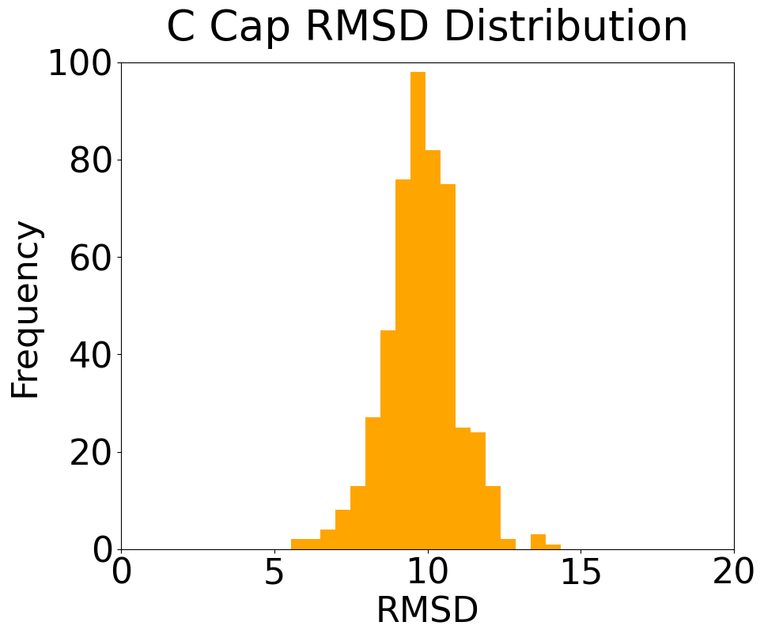
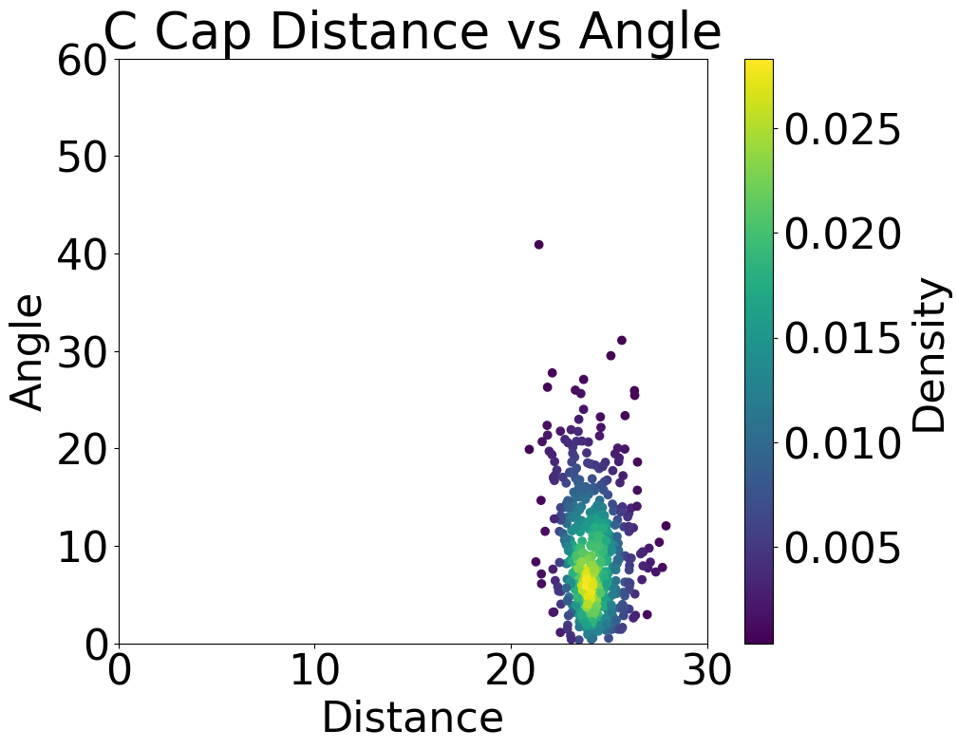
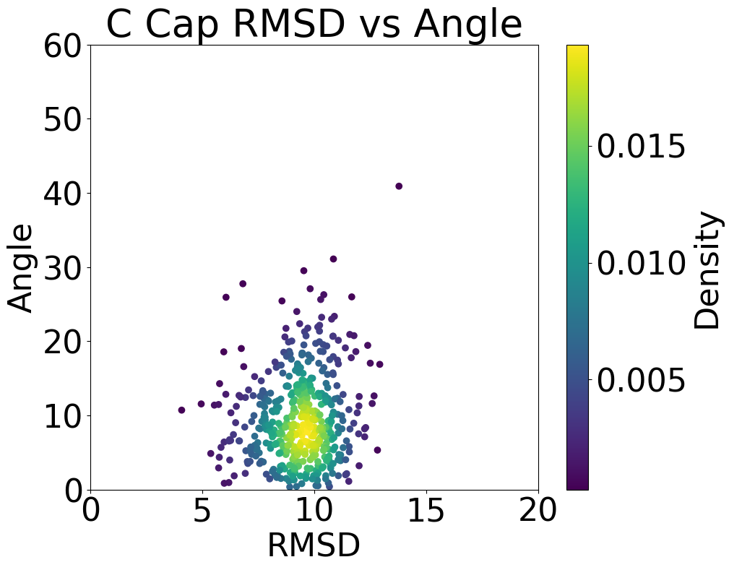
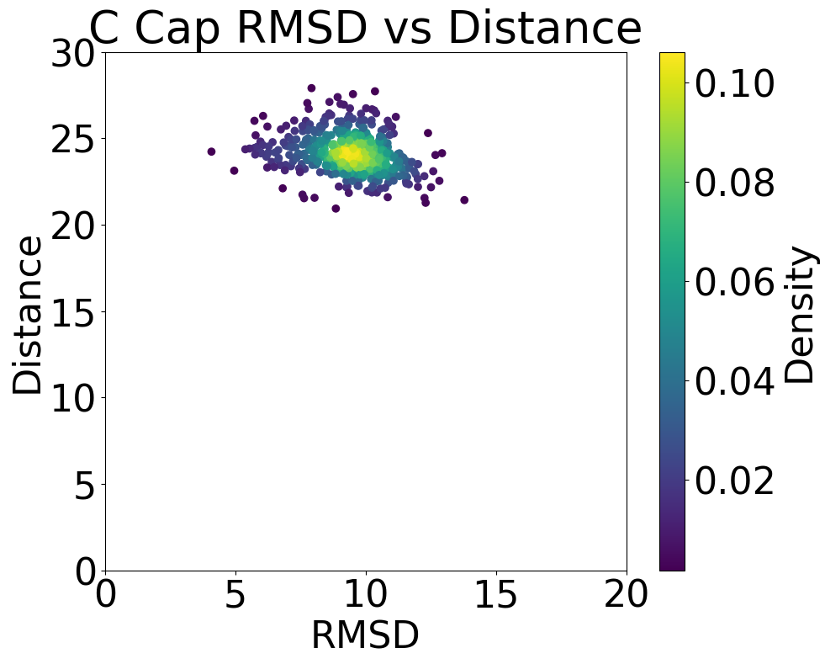
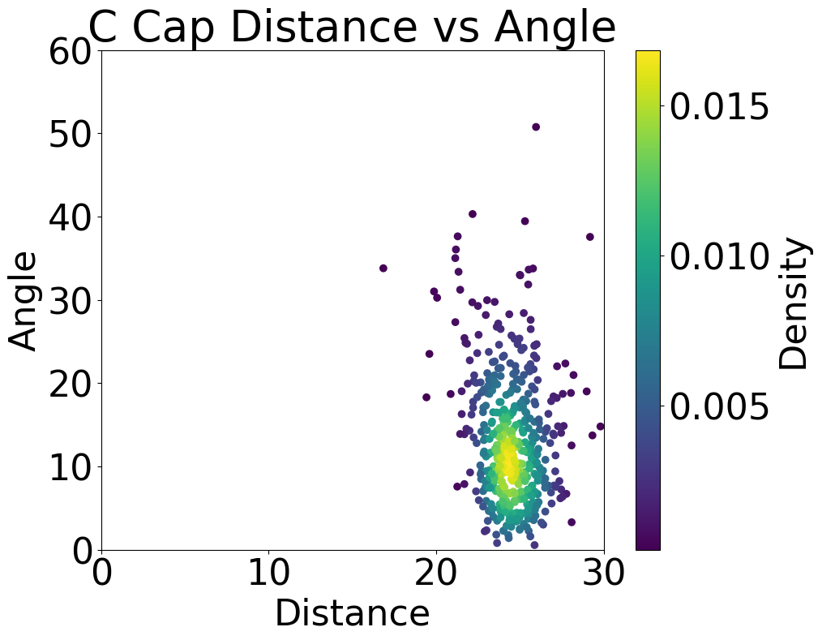
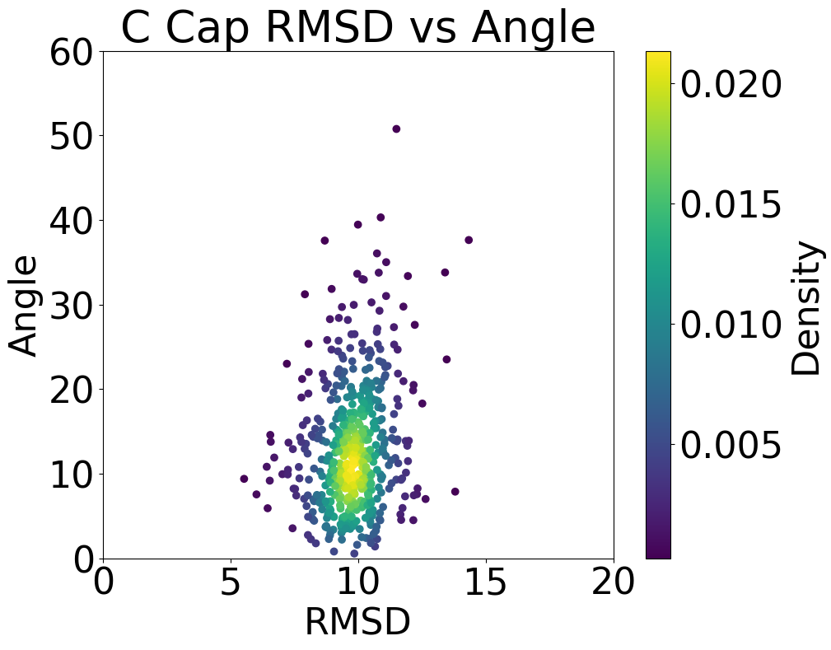
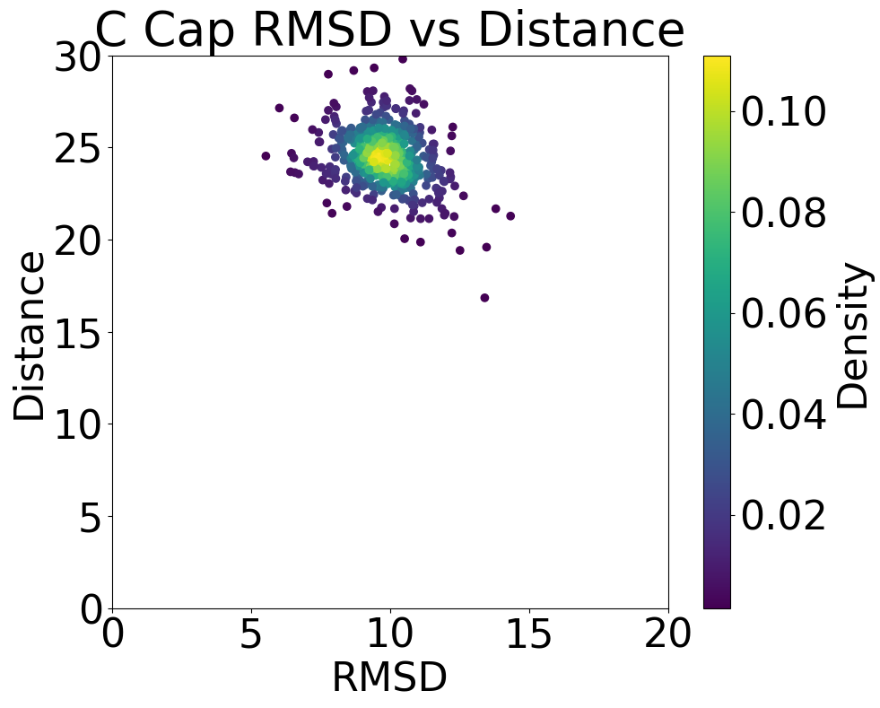
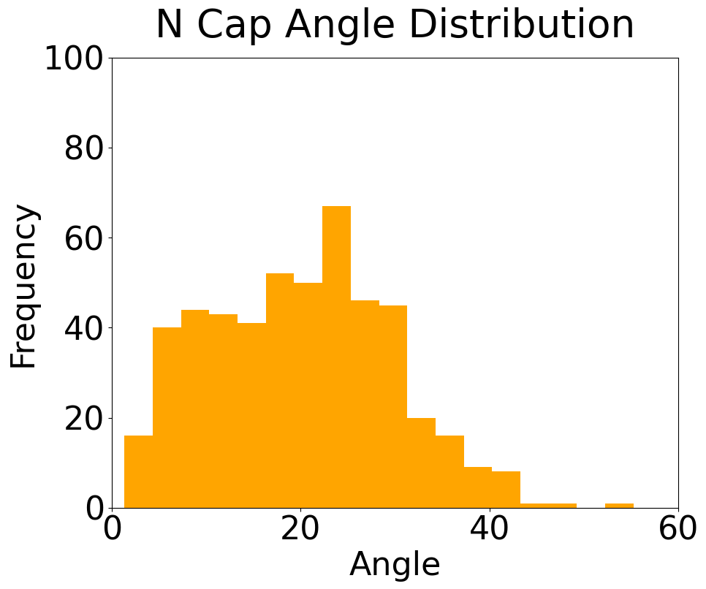
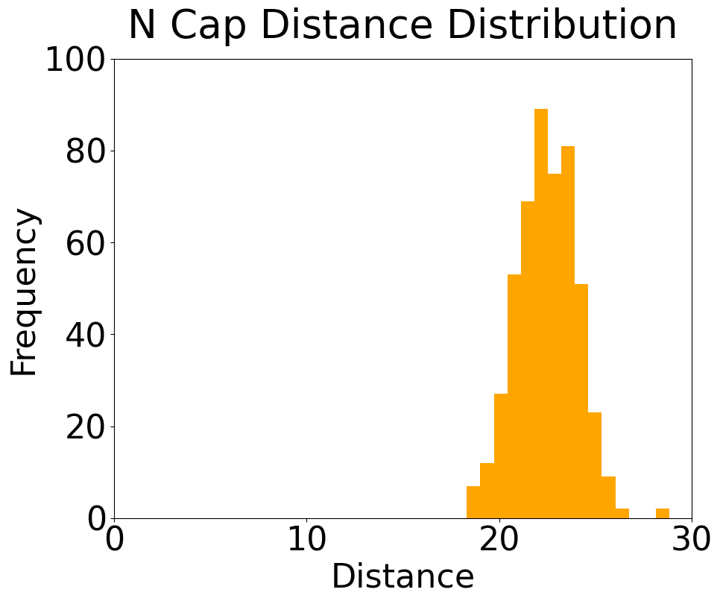
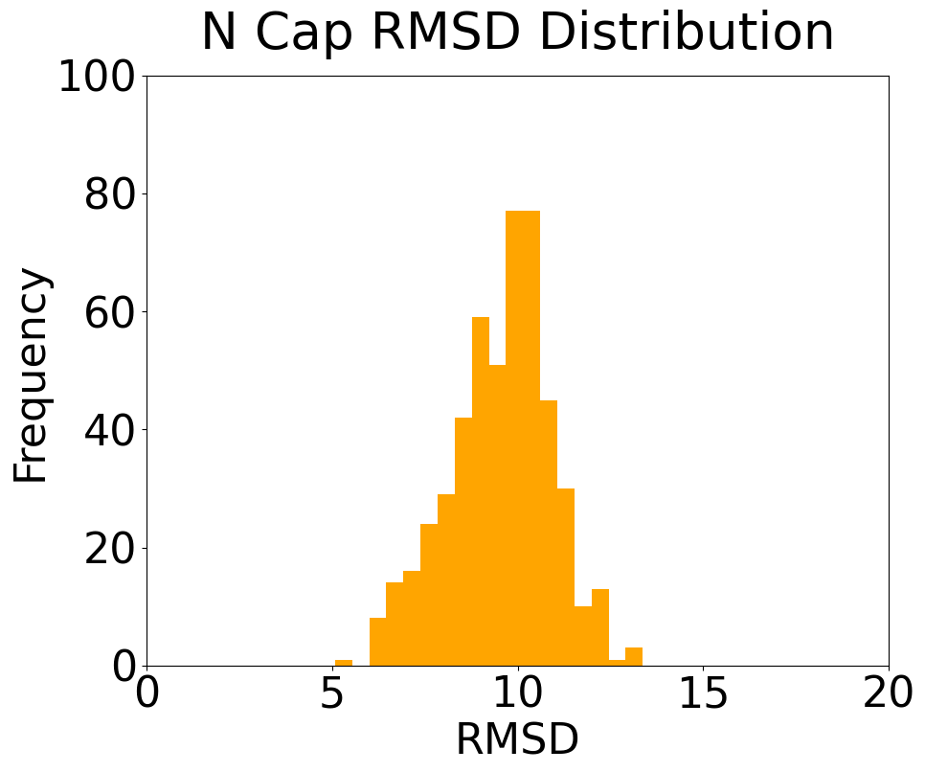
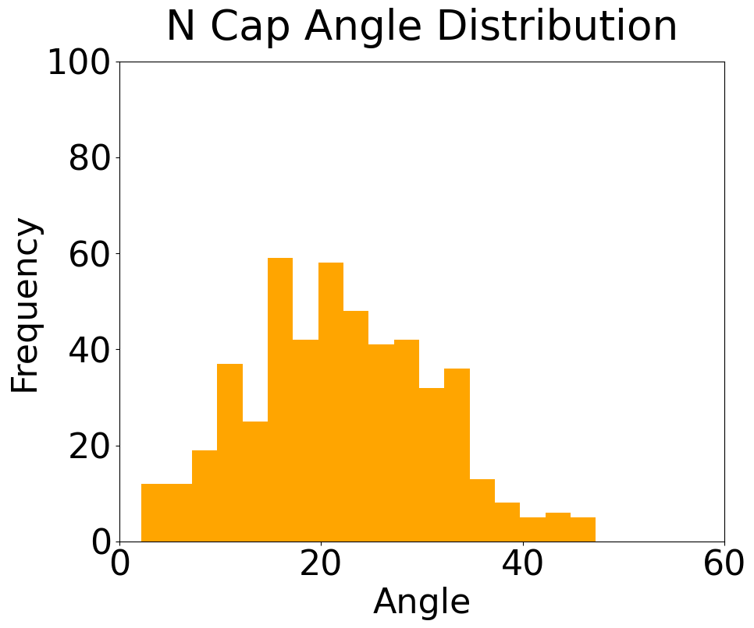
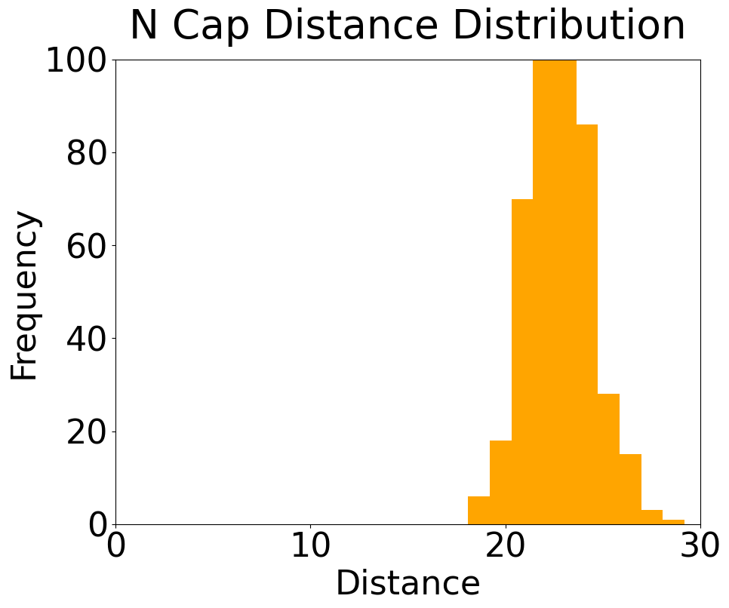
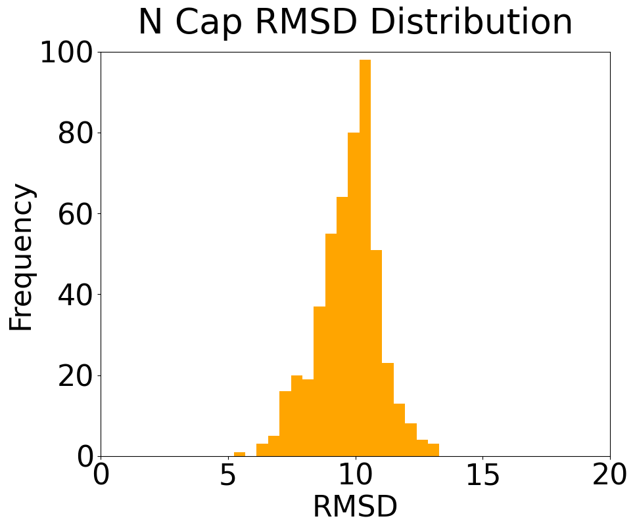
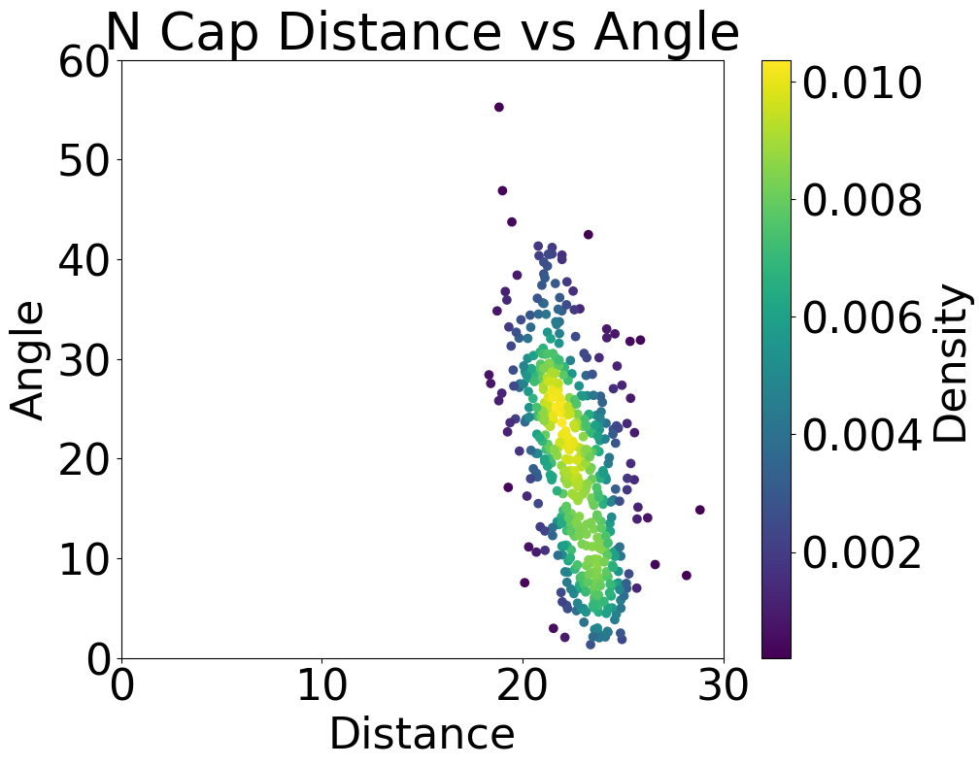
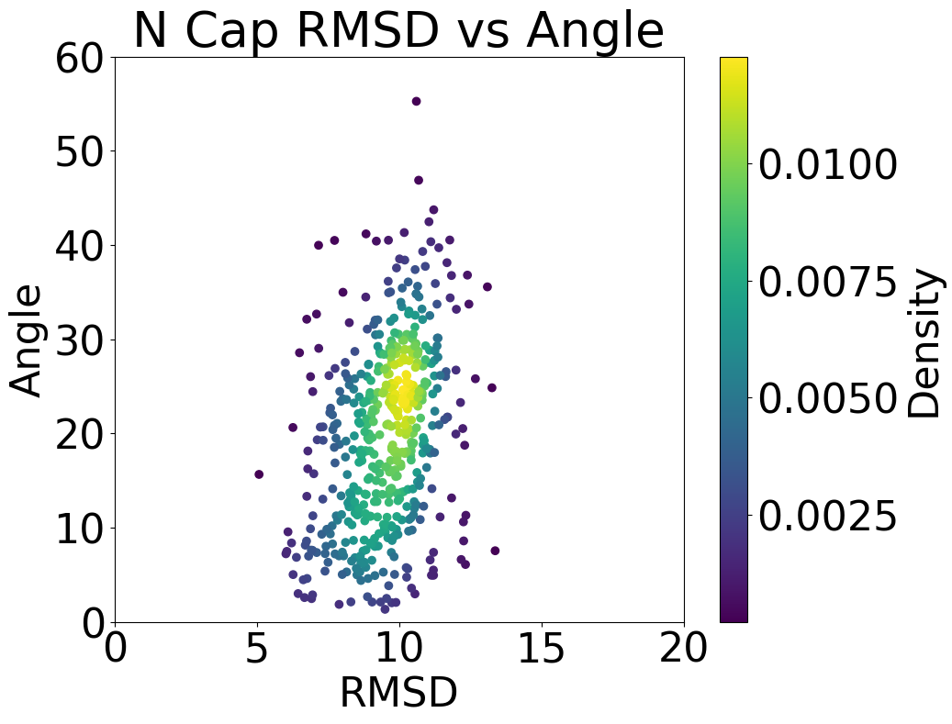
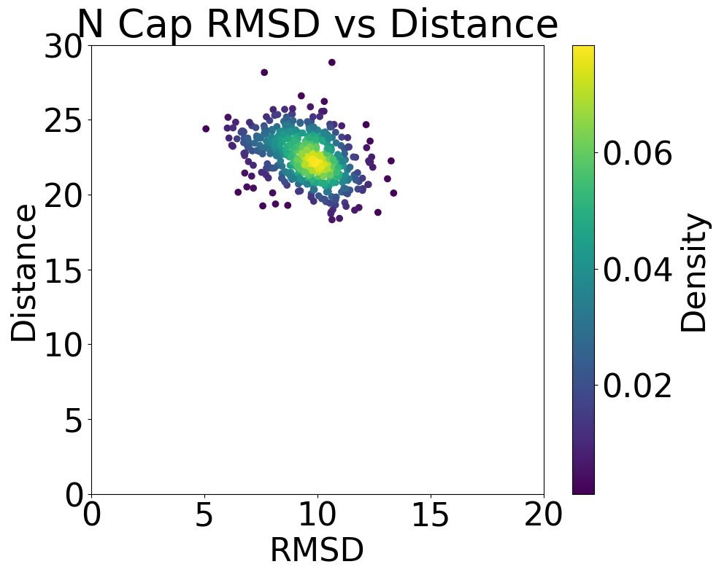
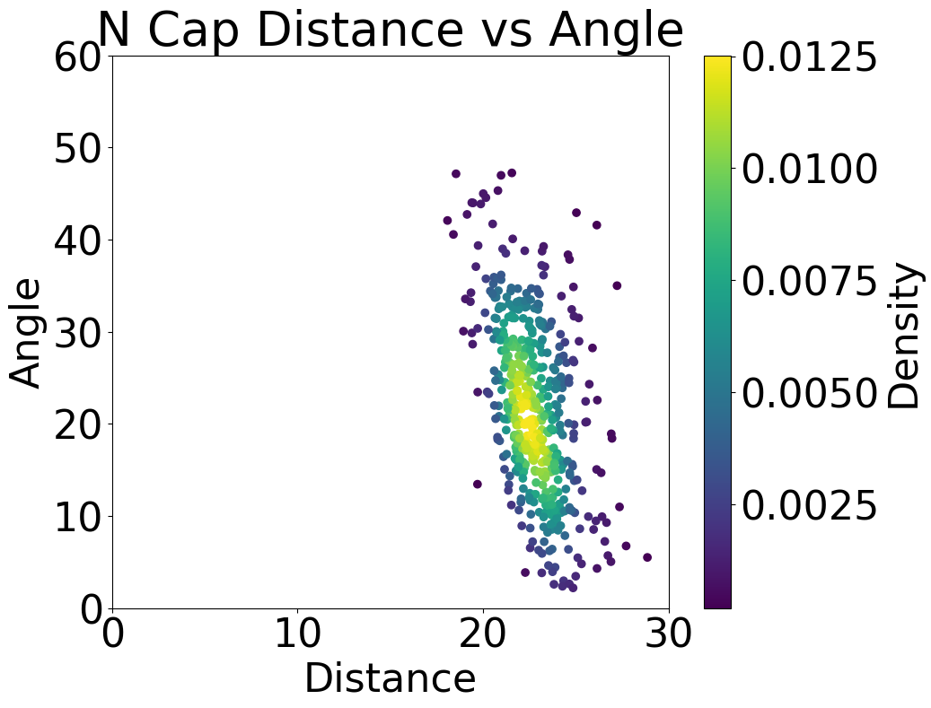
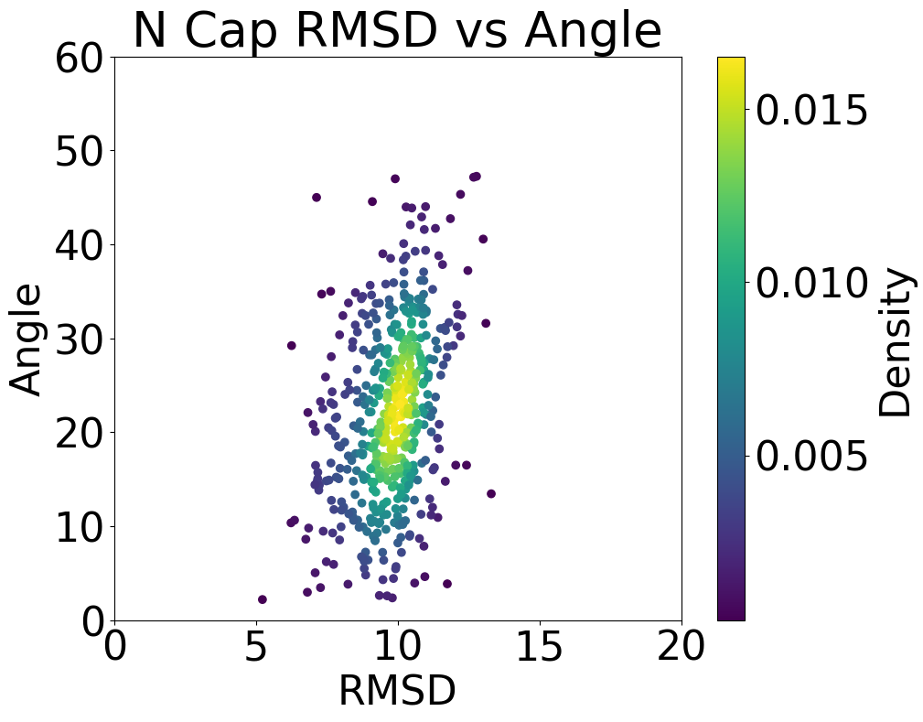
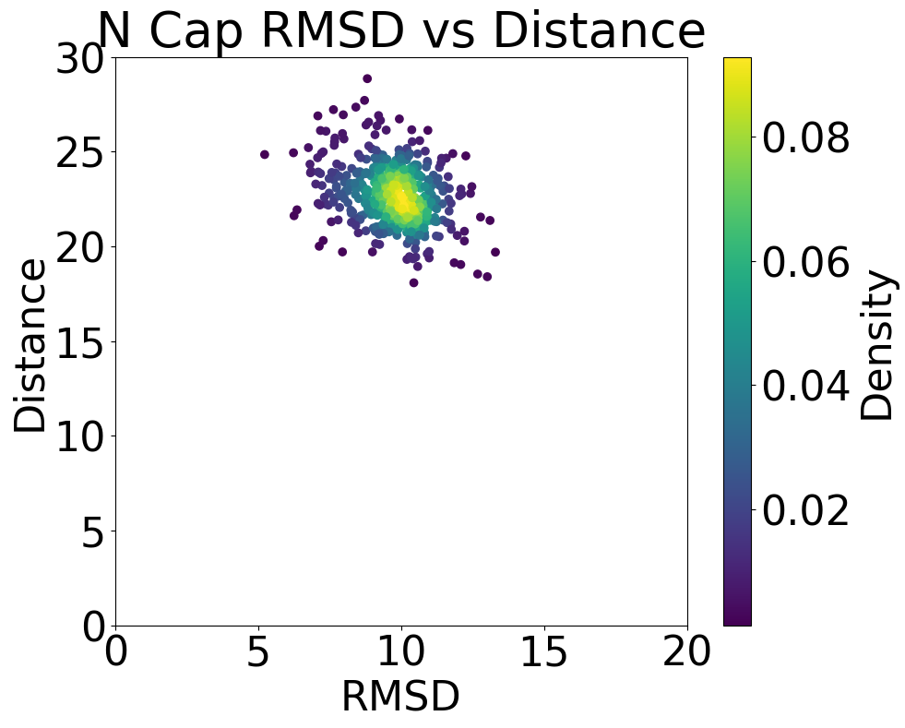
M7
M8
Pattern: [3, 3, 3, 3, 3, 3, 3, 3, 3, 3, 3, 3, 3, 3, 3, 3, 3, 3, 3, 3, 3, 3, 3, 3, 3, 3, 3, 3, 3, 3, 3, 3, 3, 3, 3, 3, 3, 3, 3, 3, 3, 3, 3, 3, 0, 0, 0, 0, 0, 0, 0, 3, 3, 3, 3, 3, 3, 3, 3, 3, 3, 3, 3, 3, 3, 3, 3, 3, 3, 3, 3, 3, 3, 3, 3, 3, 3, 3, 3, 3, 3, 3, 3, 3, 3, 3, 3, 3, 3, 3, 3, 3, 3, 3, 3, 3, 3, 3, 3, 3, 3, 3, 3, 3, 3, 3, 3, 3, 3, 3, 3, 3, 3, 3, 3, 3, 3, 3, 3, 3, 3, 3, 3, 3, 3, 3, 3, 3, 3, 3, 3, 3, 3, 3, 3, 3, 3, 3, 3, 3, 0, 0, 0, 0, 0, 0, 0, 3, 3, 3, 3, 3, 3, 3, 3, 3, 3, 3, 3, 3, 3, 3, 3, 3, 3, 3, 3, 3, 3, 3, 3, 3, 3, 3, 3, 3, 3, 3, 3, 3, 3, 3, 3, 3, 3, 3, 3, 3, 3, 3]
M8
My
version
Pattern: [0, 0, 3, 3, 3, 3, 0, 0, 3, 3, 3, 3, 0, 0, 3, 3, 3, 3, 0, 0, 3, 3, 3, 3, 0, 0, 3, 3, 3, 3, 0, 0, 3, 3, 3, 3, 0, 0, 3, 3, 3, 3, 0, 0, 3, 3, 3, 3, 0, 0, 3, 3, 3, 3, 3, 3, 3, 3, 3, 3, 3, 3, 3, 3, 3, 3, 3, 3, 3, 3, 3, 3, 3, 3, 3, 3, 3, 3, 3, 3, 3, 3, 3, 3, 3, 3, 3, 3, 3, 3, 3, 3, 3, 3, 3, 3, 3, 3, 3, 3, 3, 3, 3, 3, 3, 3, 3, 3, 3, 3, 3, 3, 3, 3, 3, 3, 3, 3, 3, 3, 3, 3, 3, 3, 3, 3, 3, 3, 3, 3, 3, 3, 3, 3, 3, 3, 3, 3, 3, 3, 3, 0, 0, 3, 3, 3, 3, 0, 0, 3, 3, 3, 3, 0, 0, 3, 3, 3, 3, 0, 0, 3, 3, 3, 3, 0, 0, 3, 3, 3, 3, 0, 0, 3, 3, 3, 3, 0, 0, 3, 3, 3, 3, 0, 0, 3, 3, 3, 3, 0, 0, 3]
M7
Tomasz
version
N cap
C cap

Slide 12
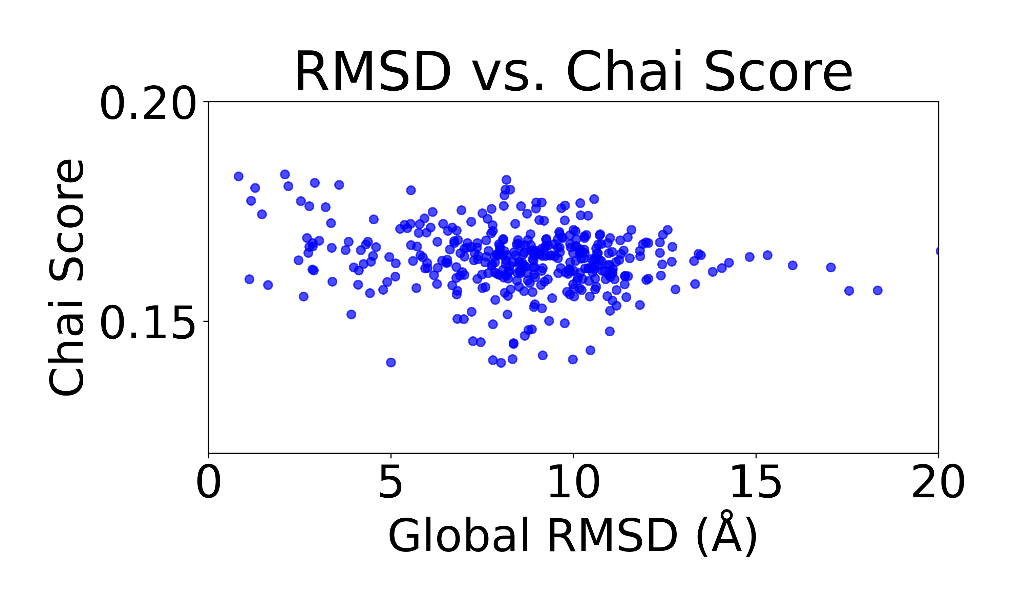
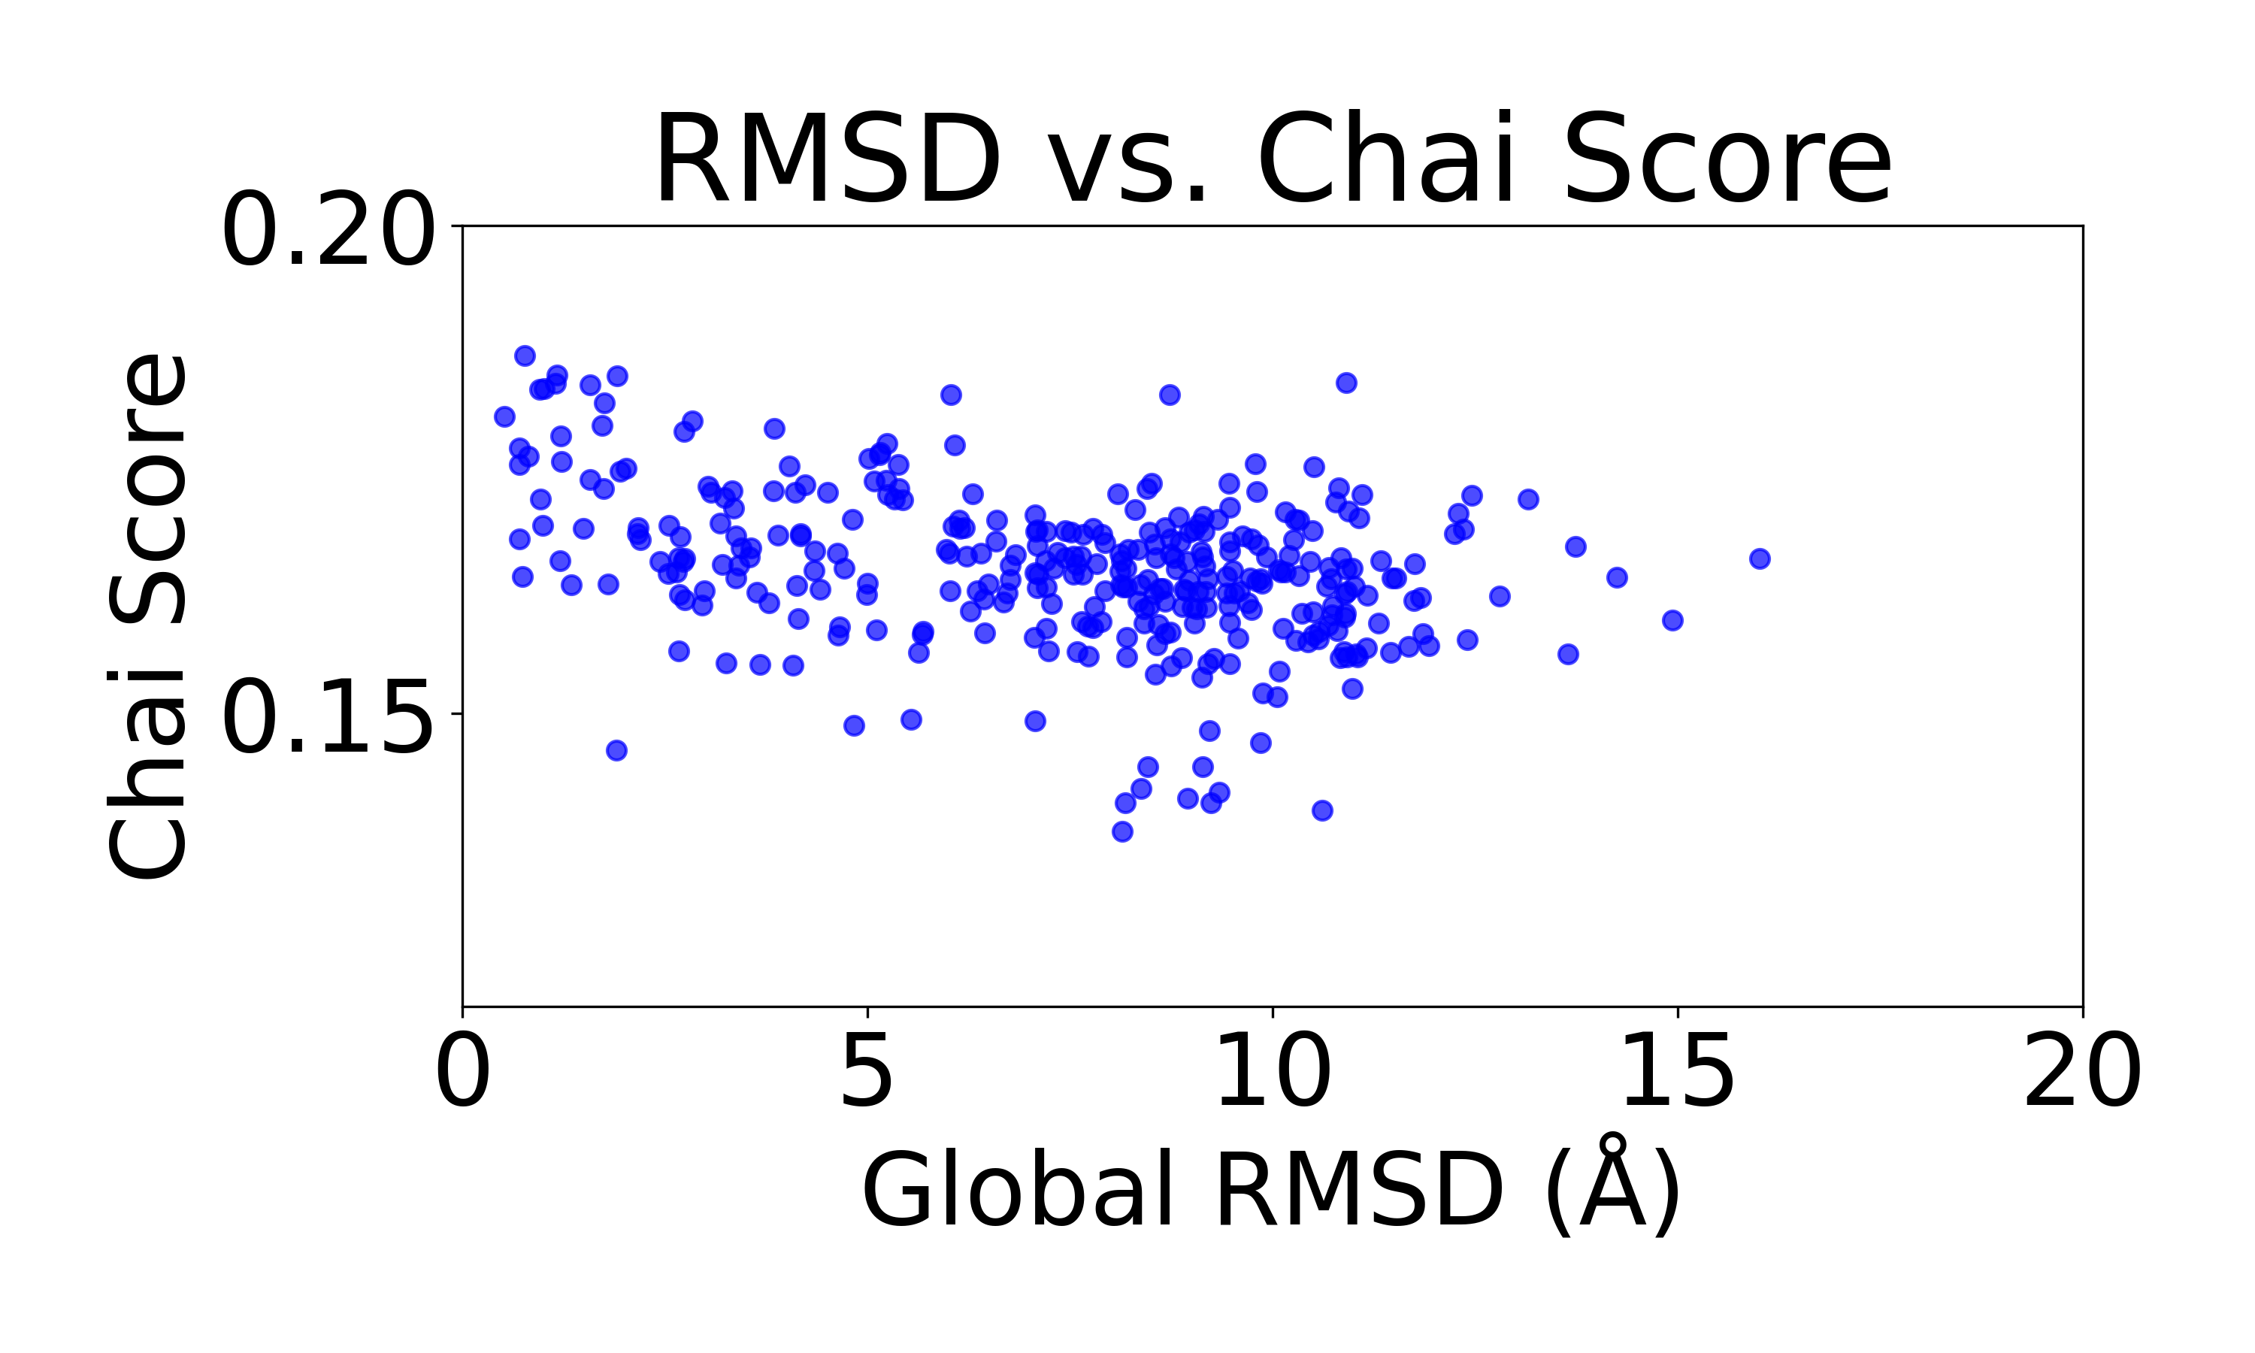
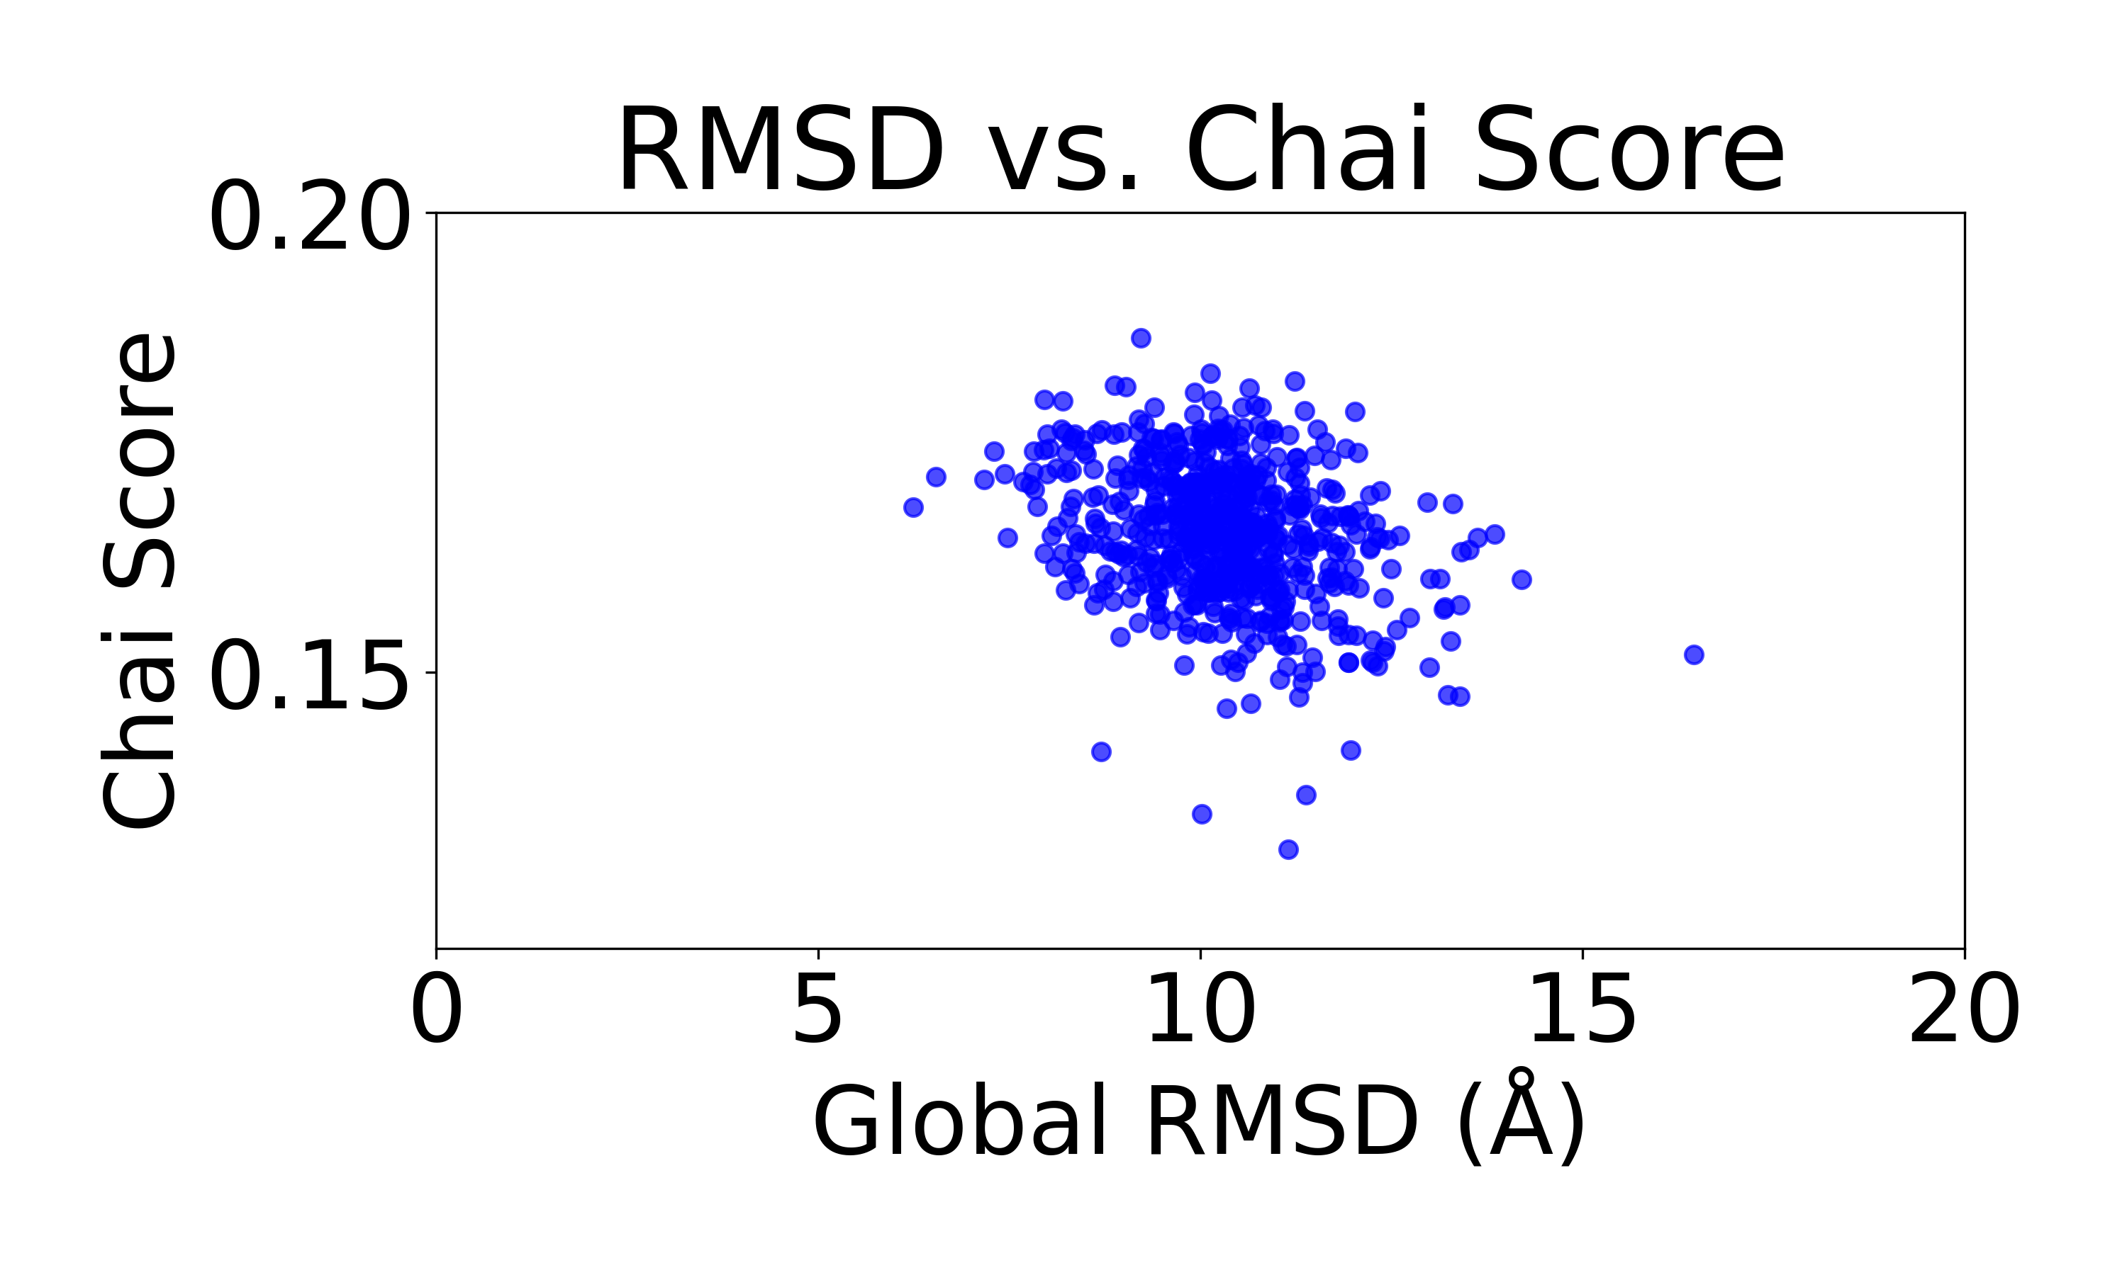

M7
M8
N cap
C cap

Slide 13
Other method attempeted
Use potential to increase the contact / radius of gyration
Total failure, maybe due to the same of the protein
To design a good cap, will need to make sure capping
at the end terminus, which increase the radius of gyration.
Provide a fake helix and partial diffusion
Combine rational design with computational
Can work but the cap’s diversity is limited
And it is not an elegant enough strategy

